Slide 1
International Conference (4)
Questions & Answers
Teaching Plan for
Questions and Answers
2018年10月

Slide 2
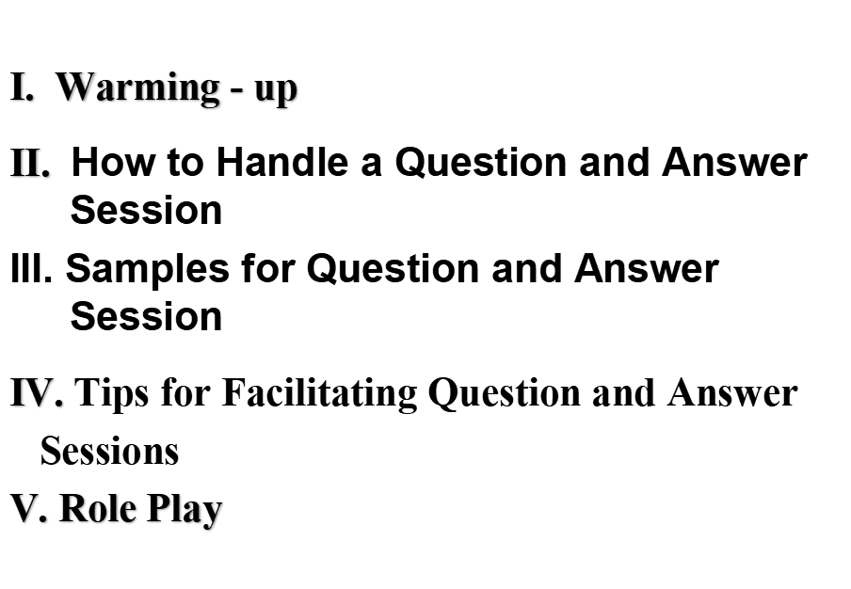
Questions & Answers

Slide 3
Questions & Answers
I. Warming - up: Group Discussion
1. Why are questions and your responses so
important?
2. What's the best way to prepare for questions?

Slide 4
3. Once the questions start coming, what
should you do?
4. What types of questions—or
questioners—should you be wary of?
5. How do you stay in control when any of
these things happens?

Slide 5
6. What about hostile questions?
7. How should you deal with hostile
questions?
8. What if there are no questions?
9. Are there other techniques that help?
10. What's the best kind of answer?

Slide 6
Questions & Answers
II. How to Handle a Question and Answer Session
The question and answer part of a lecture is a short but crucial part of a presentation. Listeners get a chance to clarify parts of the presentation and ask the speaker to expand on interesting topics. The answers may be the most memorable parts of the presentation.
c

Slide 7
The question and answer part of a lecture is a short but crucial part of
a presentation. Listeners get a chance to clarify parts of the
presentation andask the speaker to expand on interesting topics.
The answers may be the most memorable parts of the presentation.
On the other hand a badly handledQ & A will be disappointing to
the listeners or even embarrassing to the speaker.
Here are some tips to make the most of the opportunity.
On the other hand a badly handled Q & A will be disappointing to the listeners or even embarrassing to the speaker. Here are some tips to make the most of the opportunity.

Slide 8
III. Samples for Question and Answer Session
Remarks for Inviting and Asking Questions at
a Q & A Session
1. Declaring the Q & A at the Outset of the
presentation
2. Inviting Questions
3. Breaking the Silence of Tension
4. Remarks Before Raising Questions and
directing Questions

Slide 9
5. Questions for Clarifying Problems
6. Questions Showing Special Interests
7. Raising Different Opinions
8. Following up Others’ Questions
9. Shifting Topics
10. Concluding the Q & A Session

Slide 10
Remarks for Answering and Declining
Questions at a Q & A Session
1. Clarifying Questions
2. Answering Ordinary Questions
3. Repeating Previous Remarks
4. Answering Questions Partially
5. Answering Difficult Questions

Slide 11
6. Answering Questions of Agreement or
disagreement
7. Dismissing Irrelevant, Unfriendly or
unanswerable Questions
8. Turning to Others for Answers
9. Answers Giving Examples or Suggestions
10. Remarks at the End of an Answer

Slide 12
Samples for Inviting and Asking Questions at a Q & A Session

Slide 13
1. Declaring the Q & A at the Outset of the Presentation
1) At the outset（开始）, I’d like to thank you for providing time for a question and answer period. I admit I will be disappointed if you don’t have something to ask me. Please feel free to take out a pencil and jot down（草草记下） items that interest you as I speak.
2) I see that we have 15 minutes for questions and answers. During that time, I’ll be happy to answer as many of your questions as I can.

Slide 14
2. Inviting Questions
1) That’s all for the presentation. Are there any questions?
2) Thank you for your attention to my talk. Now, let’s come to the Q & A session. I hope to hear various questions from different disciplines（学科）.

Slide 15
3. Breaking the Silence of
Tension
1) Almost invariable people will come to me after a talk to ask questions. While I am happy to answer them, I know that many of these questions would have been of interest to the entire audience. So if you have something on your mind, let’s hear about it now while all can share.

Slide 16
4. Remarks Before Raising Questions and Directing Questions
1) Mr. chairman, I’d like to ask Mr. Clark a question, can I …?
Mr. Clark what do you mean by saying…?
2) I would like to ask Mr. Smith two questions. First, … Second, …

Slide 17
3) I wonder if you would like to comment on that?
4) Mr. Chairman, I did not understand Mr. Smith statement. May I ask him to repeat it once more?

Slide 18
5. Questions for Clarifying Problems
1) I would be very glad if you could give definitions to the essential concept of A used in your presentation, for I am curious why you use them in this way in your report.

Slide 19
6. Questions Showing Special Interests
1) I’m very much interested in hearing your today’s presentation, since we have studied this problem for many years. We would like to ask you to say a few more words about your work. And we would also like to exchange some materials with you..

Slide 20
7. Raising Different Opinions
1) I agree with you about the approaches to solving this problem. But so far as the application aspect is concerned, I’m afraid I can’t say that I go along with you on that. According to the result of the experiment we made last year, I think … I would like to hear YOUR opinion on this matter.

Slide 21
8. Following up Others’ Questions
1) Just now Professor Wang asked you … I’m also very interested in this subject. Would you please give us more examples to illustrate （说明）your ideas?

Slide 22
9. Shifting Topics
1) We have been talking about this subject for more than 20 minutes. Now we have only a few minutes left, shall we move on to the next subject?
2) I am very interested in the new theory you are talking about, but may I ask a question about the application of this theory?

Slide 23
10. Concluding the Q & A Session
1) Our allocated time is almost up. Now I would like to answer one more question?
2) Thank you for your questions. I hope you are satisfied with my answers. Now it is time for me to turn the floor over to Professor Smith.

Slide 24
Samples for Answering and Declining Questions at a Q & A Session

Slide 25
1. Clarifying Questions
1) I’m sorry. I didn’t hear you clearly. Would you please repeat question?
2) I am not quite sure what your question is?
3) I’m sorry. I didn’t quite get your first question. Could you clarify your first point, please?

Slide 26
2. Answering Ordinary Questions
1) It’ a good question. To answer your question, I would …
2) Thank you for your question. If I understand your question correctly, I can say that …
3) I’m very glad you asked this question. This is just the point that I want to explain again.

Slide 27
3. Repeating Previous Remarks
1) To answer Dr. Brock’s question, I would like to repeat the last point I made in my presentation.
2)To get back to the point, …

Slide 28
4. Answering Questions Partially
1) Since time is limited, I would like to answer the last point of your question.
2) As far as I know, no one has paid special attention to this subject. At the present time, I can only give you one possible explanation that …
3) I can only provide some examples to partially answer your question.

Slide 29
5. Answering Difficult Questions
1) It’s a difficult question. I’m afraid my answer cannot give you a satisfactory explanation.
2) I am not familiar with the subject, but I suppose you may be right in saying so.
3) There is not enough time to go into details, but …

Slide 30
6. Answering Questions of Agreement or
Disagreement
1) I would agree with you and Mr. Odetts on this viewpoint.
2) I think I am quite in agreement with you and there is nothing to add to this connection.

Slide 31
3) That’s not what I’m saying.
4) To avoid being misunderstood, I would like to explain myself for … It goes without saying that … What we should not forget is that…

Slide 32
7. Dismissing Irrelevant, Unfriendly or
Unanswerable Questions
1) I am very pleased at your interest in this subject, but in all fairness（说实在的） I think we should hear some questions from others now.
2) That is a very involved, personal question I’m afraid I couldn’t answer to your satisfaction. If you wish to discuss it with me after the meeting, however, I’ll be happy to do so at that time.

Slide 33
3) I’m afraid everyone present here could sense
that the remarks in your questions are less
friendly, and thatthey are far beyond the
theme of the conference.

Slide 34
8. Turning to Others for Answers
1) My colleague, Dr. Zhang, who is on my left, is the second author of this paper. I would like to leave this question to him. I’m sure Dr. Zhang will certainly give you a satisfactory answer.

Slide 35
2) Mr. Chairman, do you know anyone among the audience who is expert in this problem?
3) This is the field of John Smith. See me after the session and I’ll tell you how to contact him.

Slide 36
9. Answers Giving Examples or
Suggestions
1) I do not intent to dwell on（详述）small details, but I wish to call your attention to the fact that?
2) Here, I am just showing you a few examples of … The best one is …
3) Examining the matter in the light of past experience, we would like to suggest that…

Slide 37
10. Remarks at the End of an Answer
1) Are you satisfied with my answer?
2) Does that answer your question?
3) This is my answer to your question. What do you think of it?
4) This is my own opinion. Can I have your comments on this subject?

Slide 38
IV. Tips for Facilitating Question and
Answer Sessions
1. Anticipate（预期） likely questions and
formulate possible responses before you present.
2. When rehearsing （预演）your speech, practice
your question and answer session, too, so that you
will have practice articulating（明确有力的表达）
responses to likely questions.

Slide 39
3. Establish a time limit and inform your audience of the length when you begin the question and answer session. Be firm about cutting off questions when the predetermined （已决定的）
time is up.
4. Restate each question clearly. This helps you clarify（阐明） the question, ensures that the entire audience hears the question, and gives you a moment to consider your response.

Slide 40
5. Direct your response to the entire audience to maintain everybody’s attention.
6. Be brief. Give simple answers to simple questions. When faced with a complicated or unwieldy（难处理的） question, answer concisely and then offer to meet the questioner later for further discussion.
7. Be straightforward. If you do not know the answer to a particular question, refer the question to somebody else or offer to get back to the questioner with an answer.

Slide 41
8.Whenever possible, refer to your speech as you respond to the question. This reinforces （加强）the content of your speech and helps maintain the focus of the question and answer session.
9. Do not allow one person to dominate the question and answer session. Try to maintain momentum （势头）to sustain the interest of your audience, which can easily be lost if only one audience member is participating.

Slide 42
10. Conclude smartly. Prepare a concluding statement to indicate the end of the question and answer session and to reinforce the main points of your presentation.

Slide 43
V. Role play: (in front of the whole
class)

